Slide 1
Lecture 9-2
Backpropagation
Sung Kim <hunkim+mr@gmail.com>

Slide 2
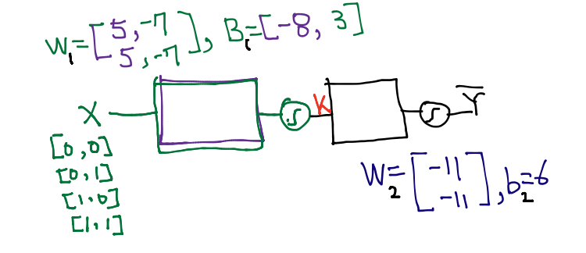
Neural Network (NN)
How can we learn W1, W2, B1, b2 from training data?

Slide 3
How can we learn W1, W2, B1, b2 from training data?
G?

Slide 4
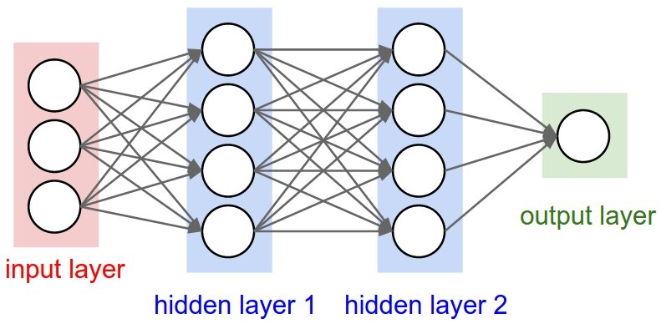
Derivation

Slide 5
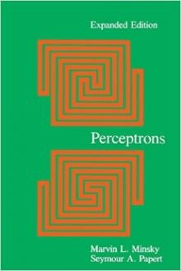
Perceptrons (1969)
by Marvin Minsky, founder of the MIT AI Lab
We need to use MLP, multilayer perceptrons (multilayer neural nets)
No one on earth had found a viable way to train MLPs good enough to learn such simple functions.
Notes:
Minsky’s book convinced most of the world that neural networks were a discredited dead-end – the worst kind of heresy.
SKynet == DeepNet, 반란군이 보낸 분일지도: Neural Network 20년 정도 발전을 늦게 함.

Slide 6
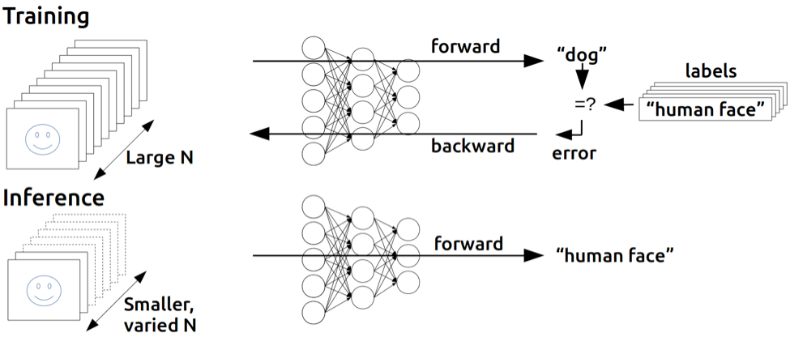
Backpropagation
(1974, 1982 by Paul Werbos, 1986 by Hinton)
https://devblogs.nvidia.com/parallelforall/inference-next-step-gpu-accelerated-deep-learning/
Notes:
민스키의 말을 듣지 않음 사람. 귓등으로 흘린분. Hinton.

Slide 7
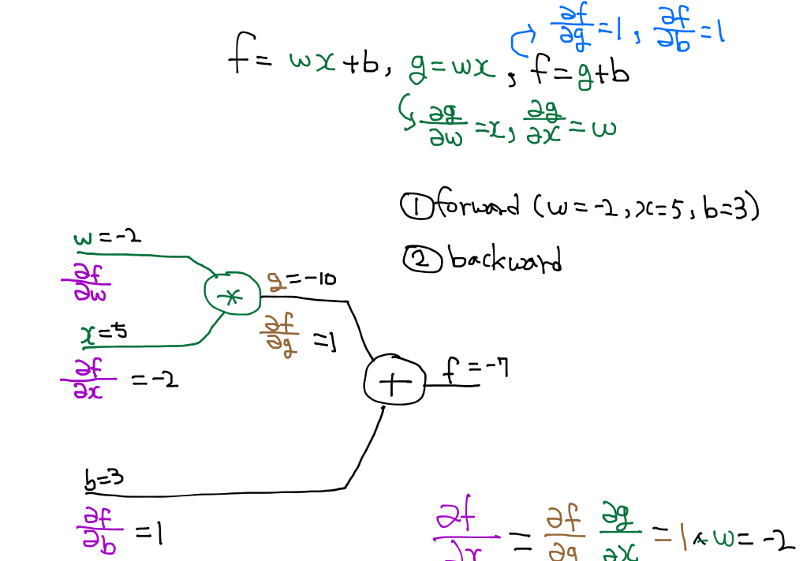
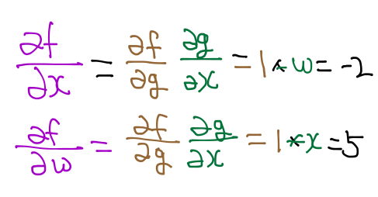
Back propagation (chain rule)

Slide 8
Back propagation (chain rule)

Slide 9
Back propagation (chain rule)

Slide 10




Basic derivative
https://ko.wikipedia.org/wiki/%EB%AF%B8%EB%B6%84
Notes:
순간변화율!

Slide 11


Partial derivative:
consider other variables as constants
https://ko.wikipedia.org/wiki/%EB%AF%B8%EB%B6%84
Notes:
The symbol ∂ looks sort of like a backwards lower-case delta, δ. It is usually read simply as “partial”, and ∂f/∂x is read as “partial f partial x”. Occasionally, the symbol ∂ is referred to as a “round d”. derivative: ∂h ∂t = dh dt = 5+ 1 t .

Slide 12




Partial derivative:
consider other variables as constants
https://ko.wikipedia.org/wiki/%EB%AF%B8%EB%B6%84
Notes:
The symbol ∂ looks sort of like a backwards lower-case delta, δ. It is usually read simply as “partial”, and ∂f/∂x is read as “partial f partial x”. Occasionally, the symbol ∂ is referred to as a “round d”. derivative: ∂h ∂t = dh dt = 5+ 1 t .

Slide 13
Back propagation (chain rule)
http://cs231n.stanford.edu/

Slide 14
Back propagation (chain rule)
http://cs231n.stanford.edu/

Slide 15
Back propagation (chain rule)
http://cs231n.stanford.edu/

Slide 16
Back propagation (chain rule)
http://cs231n.stanford.edu/

Slide 17
Back propagation (chain rule)
http://cs231n.stanford.edu/

Slide 18
Back propagation (chain rule)
w
http://cs231n.stanford.edu/

Slide 19
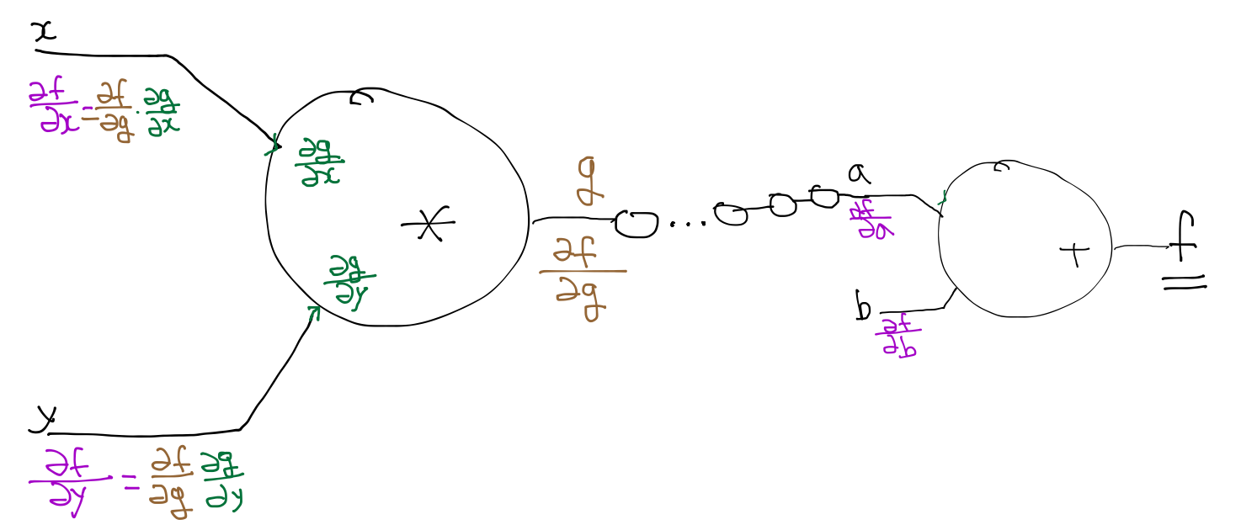
Back propagation (chain rule)
http://cs231n.stanford.edu/

Slide 20
Back propagation (chain rule)
http://cs231n.stanford.edu/

Slide 21
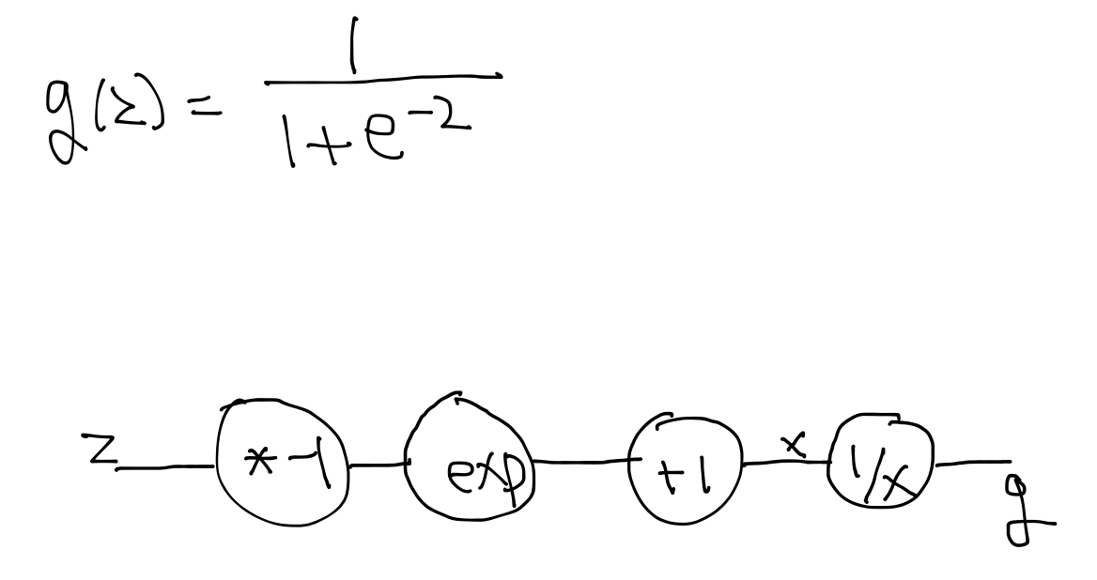
Sigmoid

Slide 22
Sigmoid

Slide 23
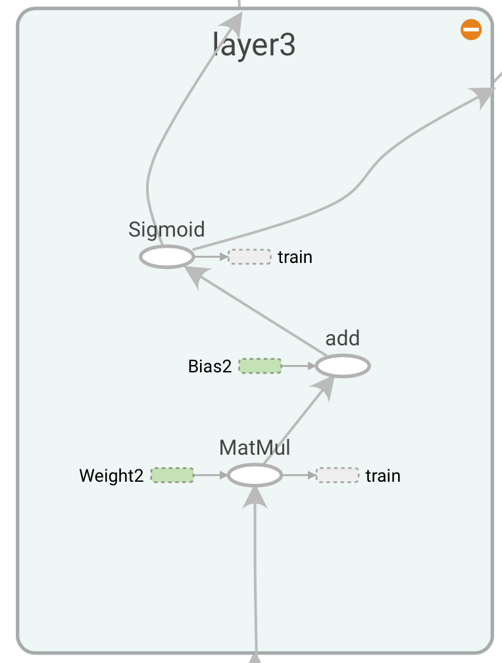
Back propagation in
TensorFlow
TensorBoard

Slide 24
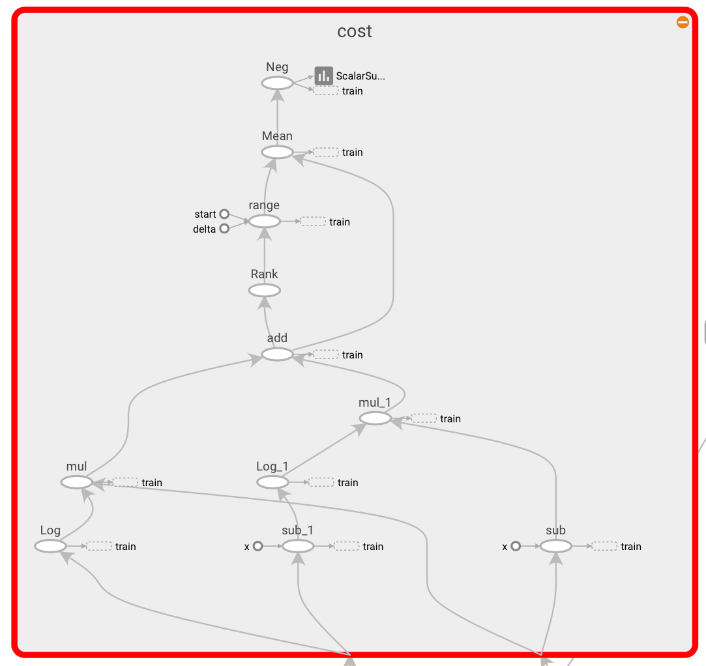
Back propagation in
TensorFlow
TensorBoard

Slide 25
Back propagation

Slide 26
Perceptrons (1969)
by Marvin Minsky, founder of the MIT AI Lab
We need to use MLP, multilayer perceptrons (multilayer neural nets)
No one on earth had found a viable way to train MLPs good enough to learn such simple functions.
Notes:
Minsky’s book convinced most of the world that neural networks were a discredited dead-end – the worst kind of heresy.
SKynet == DeepNet, 반란군이 보낸 분일지도: Neural Network 20년 정도 발전을 늦게 함.

Slide 27

Next
ReLU

